Slide 1
Evaluation of project management
Aneeqa Azhar
BSCS-F19-M-69
Section “B”

Slide 2
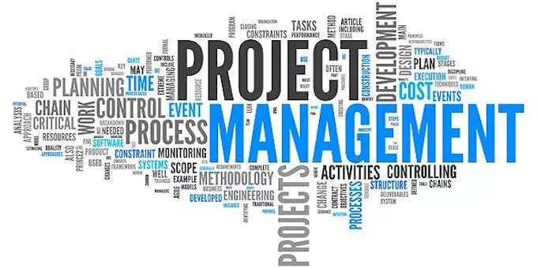
Introduction of Project Management

Slide 3
Cont…
Define Project Goal , Scope.
Set target
Appoint the project team
Define role and responsibilities
Fix issues
Training
Track effort and cost.

Slide 4
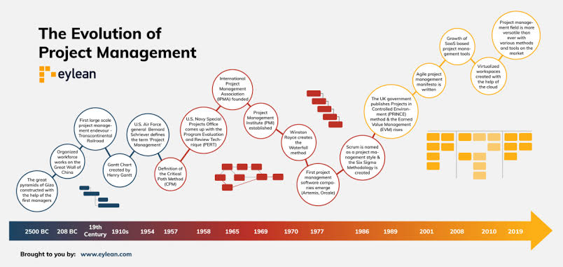
Background

Slide 5
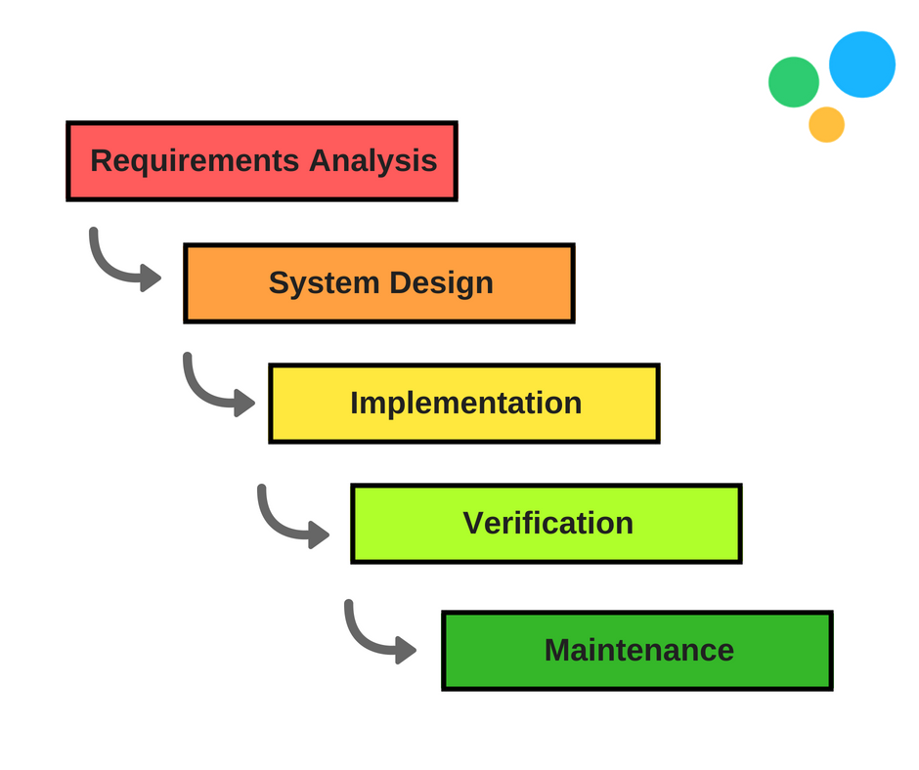

Methodologies

Slide 6
Project Evaluation
Step by step process of collecting , recording and organizing information about
Project result.
Short term output.
Long term output.
Risk analysis.
Cost benefit evaluation.

Slide 7
Conclusion
Project management helps to detail what tasks will be accomplished, who will be involved in completing the tasks, and when tasks should start and finish. Typically, projects progress in steps or incremental stages; however, other approaches for rapid, interactive project management are also widely used.

